Slide 1
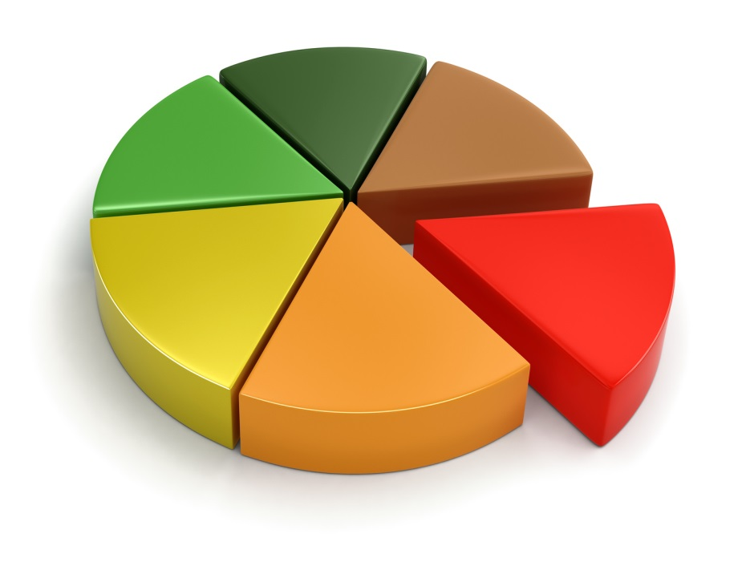
What is the Minimum You Have to Believe to be a Follower of Jesus?

Slide 2


What is the minimum I have to believe to be a Follower of Jesus?
What would you say …?

Slide 3
What is the minimum I have to believe to be a Follower of Jesus?
1. Some practical questions for sharing the Good News
what is essential?
what sort of language?
what about culture?
what about different “streams” of the church?
the difference between proclamation and teaching

Slide 4
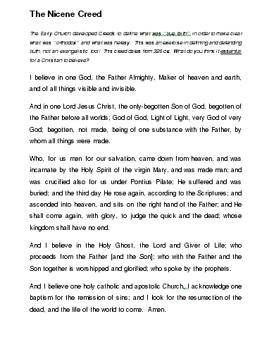
What is the minimum I have to believe to be a Follower of Jesus?
1. Some practical questions for sharing the Good News

Slide 5
What is the minimum I have to believe to be a Follower of Jesus?
2. What was Jesus’ message?
God’s authoritative rule
“… The time has come: the kingdom of God has come near. Repent and believe the Good News”
Mark 1 ¹⁵
Change the direction of your life
Put your trust in

Slide 6
What is the minimum I have to believe to be a Follower of Jesus?
2. What was Jesus’ message?
…a Holy-Spirit-enabled proclamation for the poor – of freedom, new sight and good things from God
Luke 4 ¹⁶⁻²², quoting Isaiah 61

Slide 7
What is the minimum I have to believe to be a Follower of Jesus?
2. What was Jesus’ message?
“The Son of Man did not come to be served, but to serve, and to give his life as a ransom for many”
Mark 10 ⁴⁵

Slide 8
What is the minimum I have to believe to be a Follower of Jesus?
3. What did the first Christians preach?
Acts 2 ¹⁴⁻³⁹ – Peter Pentecost | included in both | Acts 17 ²²⁻³¹ – Paul at Athens
What you see was prophesied | An appointed Man | You show interest in religion
Jesus | God raised Him from death | You honour an “unknown God”
You put him to death | Repent | God is the source of all things
Resurrection prophesied |  | God wants you to seek Him
Now you see the Spirit given |  | Your poets have glimpsed this
Jesus is Lord and Messiah
Be baptised in Jesus’ name
You will receive the Spirit

Slide 9
What is the minimum I have to believe to be a Follower of Jesus?
4. How is the Good News presented elsewhere?
Romans 1 ¹⁻⁴ | 1 Corinthians 15 ²¹
The Good News promised | Christ died for our sins
Through the prophets and scriptures | According to the scriptures
Regarding God’s Son, Jesus | Raised on the third day
A descendant of David | Appeared to many
Appointed Son of God
Through power of resurrection

Slide 10
What is the minimum I have to believe to be a Follower of Jesus?
4. How is the Good News presented elsewhere?
“ … you will be saved, if you honestly say, "Jesus is Lord," and if you believe with all your heart that God raised him from death.”
Romans 10 ⁹

Slide 11
What is the minimum I have to believe to be a Follower of Jesus?
4. How is the Good News presented elsewhere?
The “kerygma”
God’s promises have been fulfilled …
… in Jesus’ birth’ life, ministry, death and resurrection …
… after which Jesus returned to the Father …
… His work now evidenced by the Holy Spirit.
(Jesus will return at the end of the age).

Slide 12
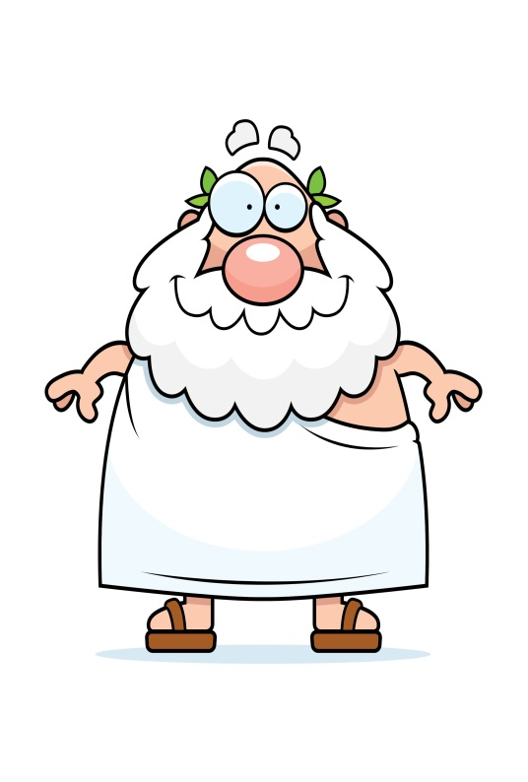
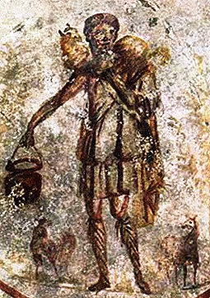

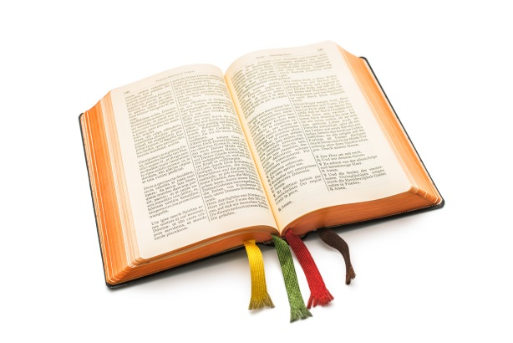
What is the minimum I have to believe to be a Follower of Jesus?
#1 There is a God, who loves me

Slide 13
What is the minimum I have to believe to be a Follower of Jesus?
#1 There is a God, who loves me
you don’t have to believe that everything the Bible says about God is literally true
you don’t have to believe that science is wrong about the big bang & evolution
you don’t have to believe in a six day creation
you don’t have to explain the Trinity or virgin birth
you don’t have to have a perfect answer to the problem of suffering

Slide 14



What is the minimum I have to believe to be a Follower of Jesus?
#2 I’ve been off course …

Slide 15
What is the minimum I have to believe to be a Follower of Jesus?
#2 I’ve been off course …
you don’t have to believe that you are a wholly bad person
you don’t have to deny the good in you, or the good you have achieved
you don’t have to pray the “sinner’s prayer”
you don’t have to be focussed on God as “judge”

Slide 16
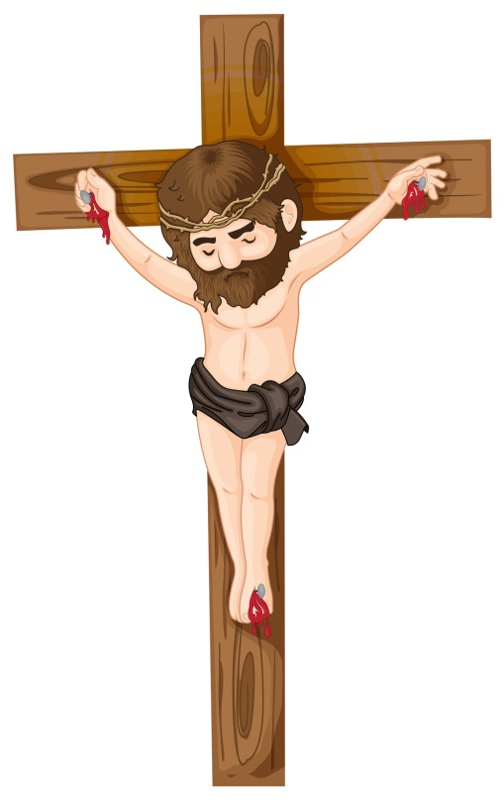
What is the minimum I have to believe to be a Follower of Jesus?
#3 God took the initiative …

Slide 17
What is the minimum I have to believe to be a Follower of Jesus?
#3 God took the initiative …
you don’t have to accept literally particular doctrines of the atonement
you don’t have to believe that your wrong-doing deserves the death penalty
you don’t have to believe that God’s greatest characteristic is punishment

Slide 18

What is the minimum I have to believe to be a Follower of Jesus?
#4 I need to change course …

Slide 19
What is the minimum I have to believe to be a Follower of Jesus?
#4 I need to change course …
you don’t have to promise to be perfect from now on. That won’t happen. But you must be willing to change, and to be changed
you don’t have to have deep feelings of regret – simply to recognise where you are

Slide 20
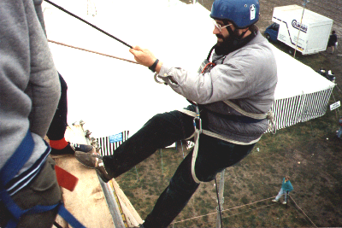
What is the minimum I have to believe to be a Follower of Jesus?

Slide 21
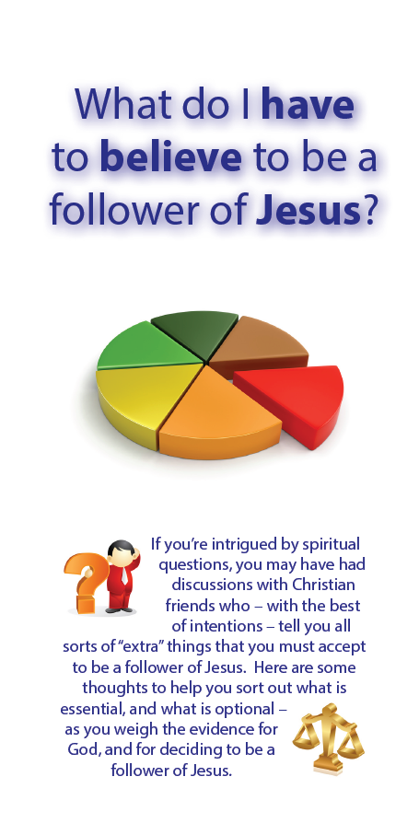

What is the minimum I have to believe to be a Follower of Jesus?

