Slide 1
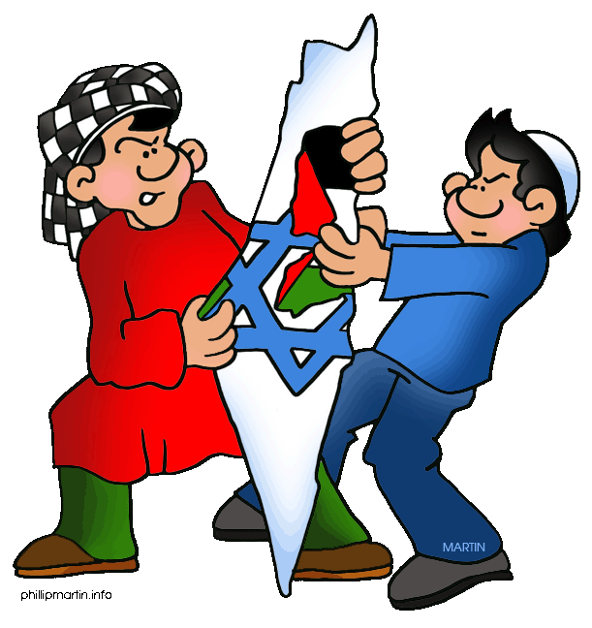
A (simplified) history of the Arab-Israeli conflict

Slide 2
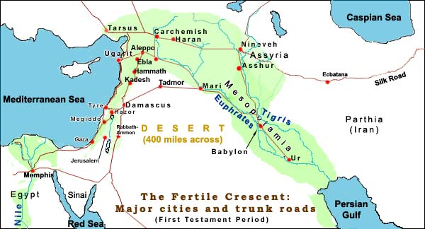
A (simplified) history of the Arab-Israeli conflict

Slide 3








2000 BCE 1500 BCE 1000 BCE 500 BCE 0 500 CE
Abraham
Moses
David
Exile
Jesus
… then are overwhelmed by the Assyrians …
… who are defeated by the Babylonians …
… who succumb to the Persians, who are conquered by the Greeks …
… who are beaten by the Romans …
Egypt rules!
The Israelites …
defeat the Canaanites
Bible History for Complete Bozos
from 586 BCE to 1948 CE, Jewish people do not rule the Land
A (simplified) history of the Arab-Israeli conflict

Slide 4
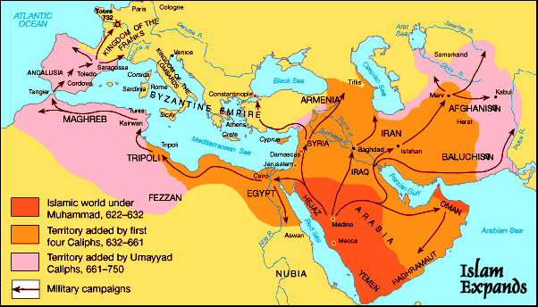

0 CE 500 CE 1000 CE 1500 CE 2000CE
A (simplified) history of the Arab-Israeli conflict
Notes:
Emergence of Islam: Qur’an: 610-632

Slide 5
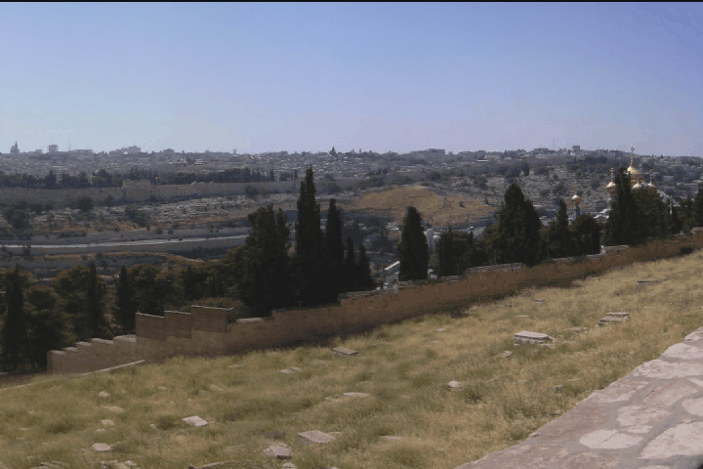

0 CE 500 CE 1000 CE 1500 CE 2000CE
A (simplified) history of the Arab-Israeli conflict
Notes:
Dome of Rock 685

Slide 6
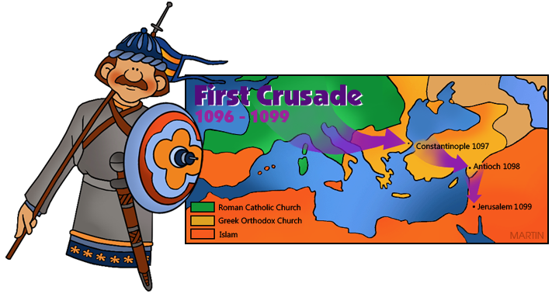
0 CE 500 CE 1000 CE 1500 CE 2000CE
Apart from some brief periods during the Crusades, the Holy Land remains under Muslim control until the end of the Ottoman era in the early 20th century
A (simplified) history of the Arab-Israeli conflict
Notes:
Mamluks 1291 to 1517

Slide 7
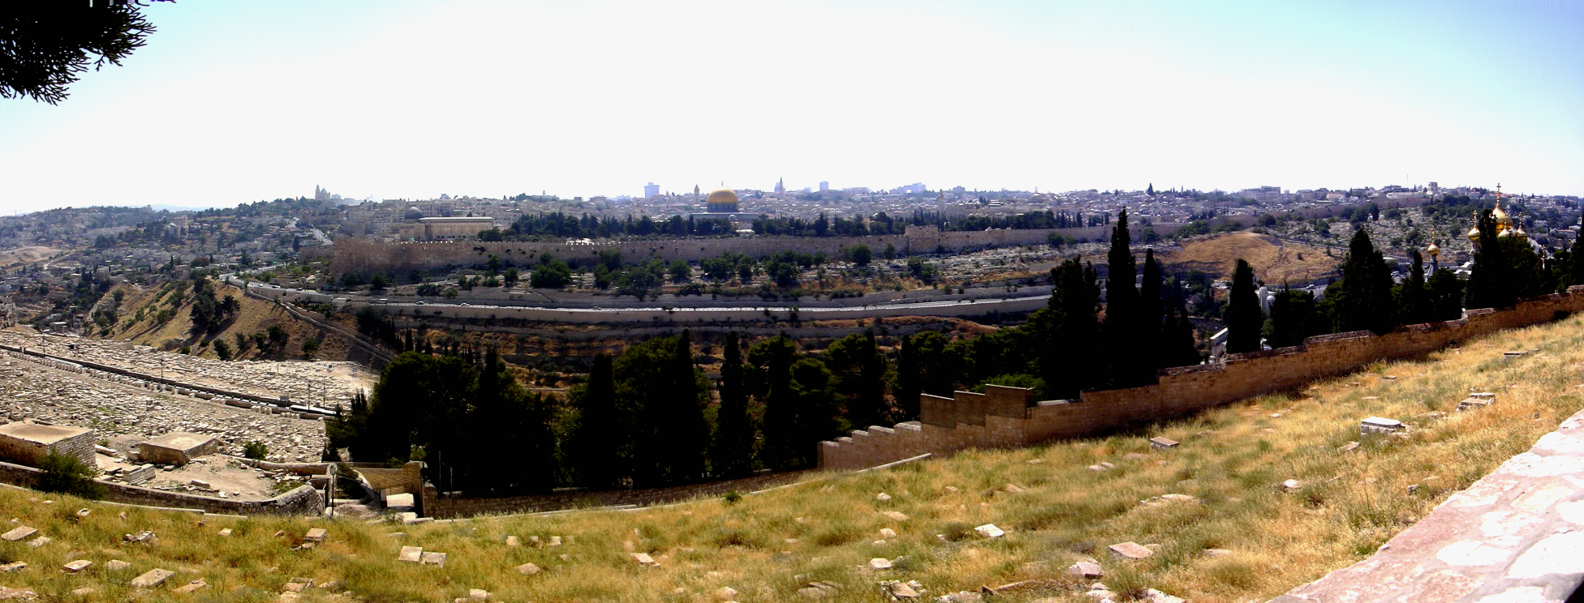
0 CE 500 CE 1000 CE 1500 CE 2000CE
A (simplified) history of the Arab-Israeli conflict
Notes:
Sulemain the Magnificent 16th century

Slide 8

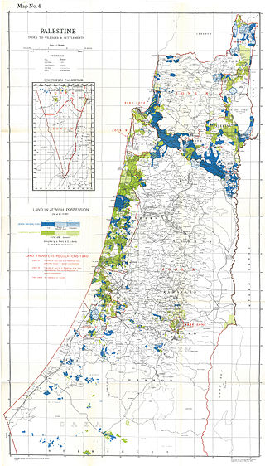
0 CE 500 CE 1000 CE 1500 CE 2000CE
in second half of 19th century, start of Jewish migration to Palestine
in late 19th century, emergence of Zionism
1917: “Balfour Declaration”
by 1944, 6% of land Jewish-owned
A (simplified) history of the Arab-Israeli conflict
Notes:
Theodore Herzl 1897
UK Foreign Secretary to Baron Rothschild:
“His Majesty's government view with favour the establishment in Palestine of a national home for the Jewish people, and will use their best endeavours to facilitate the achievement of this object, it being clearly understood that nothing shall be done which may prejudice the civil and religious rights of existing non-Jewish communities in Palestine, or the rights and political status enjoyed by Jews in any other country”

Slide 9
0 CE 500 CE 1000 CE 1500 CE 2000CE
from 1919 – British Mandate in Palestine …
A (simplified) history of the Arab-Israeli conflict
Notes:
Plan accepted by Jews, rejected by Arab nations

Slide 10
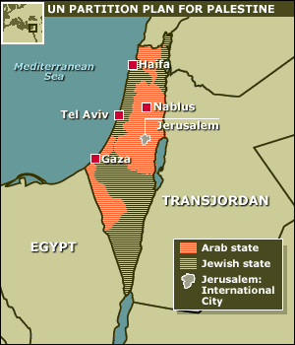
0 CE 500 CE 1000 CE 1500 CE 2000CE
from 1919 – British Mandate in Palestine …
1947: United Nations proposal
1948: Jewish State of Israel declared
A (simplified) history of the Arab-Israeli conflict
Notes:
Plan accepted by Jews, rejected by Arab nations

Slide 11
0 CE 500 CE 1000 CE 1500 CE 2000CE
from 1919 – British Mandate in Palestine …
1947: United Nations proposal
1948: Jewish State of Israel declared
war with surrounding Arab nations
1½ million Arab refugees flee
allegations of “ethnic cleansing”
at ceasefire, major Israeli gains
1947
A (simplified) history of the Arab-Israeli conflict

Slide 12
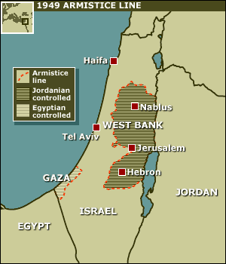
0 CE 500 CE 1000 CE 1500 CE 2000CE
1949
1947
A (simplified) history of the Arab-Israeli conflict
Notes:
for Israelis: 1948 = Independence Day
for Palestinians: the Nakba
1964: PLO
EXPLAIN: West Bank and Gaza

Slide 13
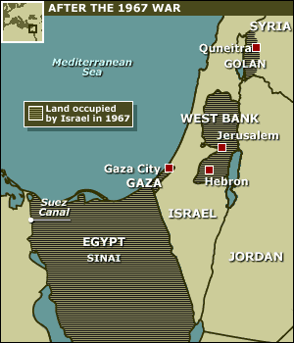
0 CE 500 CE 1000 CE 1500 CE 2000CE
1973: Yom Kippur war
1987-1993: first “intifada”
1995: Palestinian Authority
1995: Oslo Accord
1967
1947
A (simplified) history of the Arab-Israeli conflict
Notes:
Intifada = shaking off

Slide 14
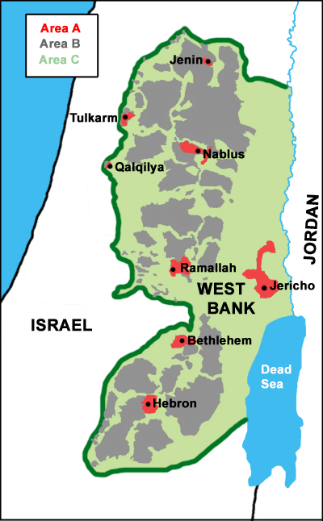
0 CE 500 CE 1000 CE 1500 CE 2000CE
Today:
area A: full Palestinian control (18% of West Bank)
area B: Palestinian civil control, joint security control (22%)
area C: full Israeli civil and security control (61%)
A (simplified) history of the Arab-Israeli conflict
Notes:
Oslo 2 1995

Slide 15
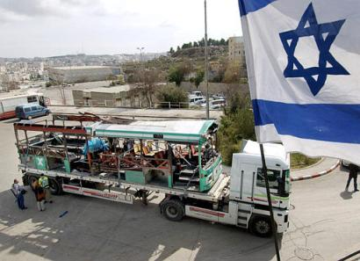
0 CE 500 CE 1000 CE 1500 CE 2000CE
1973: Yom Kippur war
1987-1993: first “intifada”
1995: Palestinian Authority
1995; Oslo Accord
A (simplified) history of the Arab-Israeli conflict
Notes:
Keren Milchiker 29th January 2004.
11 passengers died

Slide 16
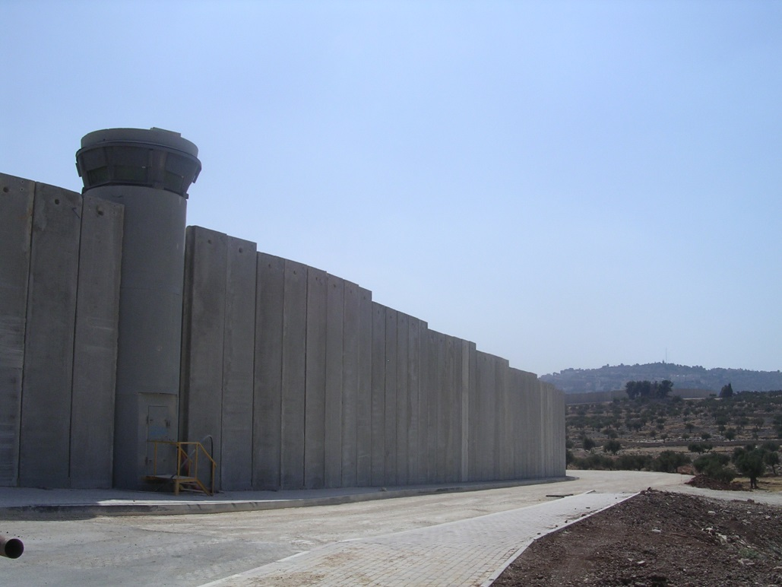

0 CE 500 CE 1000 CE 1500 CE 2000CE
A (simplified) history of the Arab-Israeli conflict
Notes:
Intifada = shaking off

Slide 17
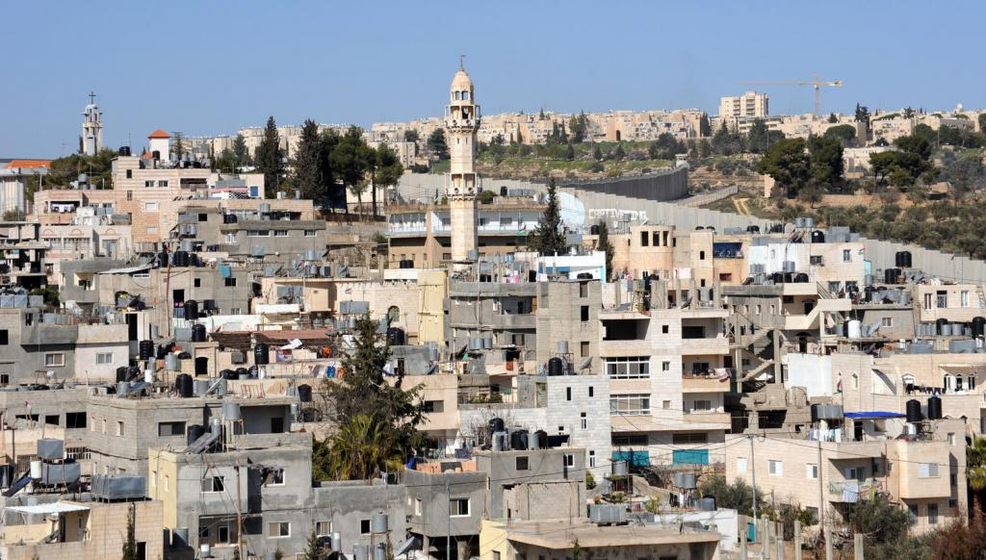
0 CE 500 CE 1000 CE 1500 CE 2000CE
A (simplified) history of the Arab-Israeli conflict
Notes:
Aida refugee camp Bethlehem

Slide 18
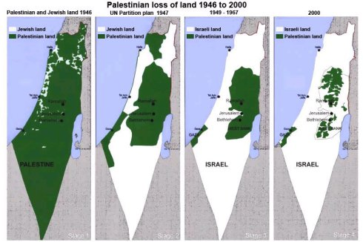
0 CE 500 CE 1000 CE 1500 CE 2000CE
A (simplified) history of the Arab-Israeli conflict
Notes:
Intifada = shaking off

Slide 19
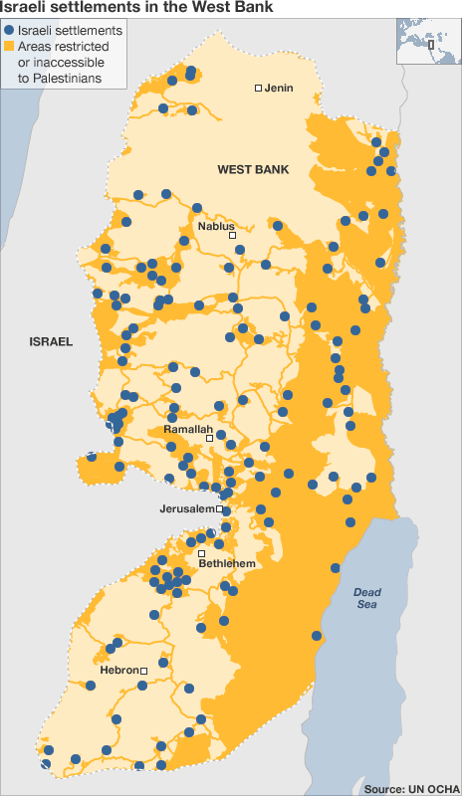
0 CE 500 CE 1000 CE 1500 CE 2000CE
Today:
125 settlements
100 + “settler outposts”
547,000 settlers
A (simplified) history of the Arab-Israeli conflict
Notes:
International law

Slide 20
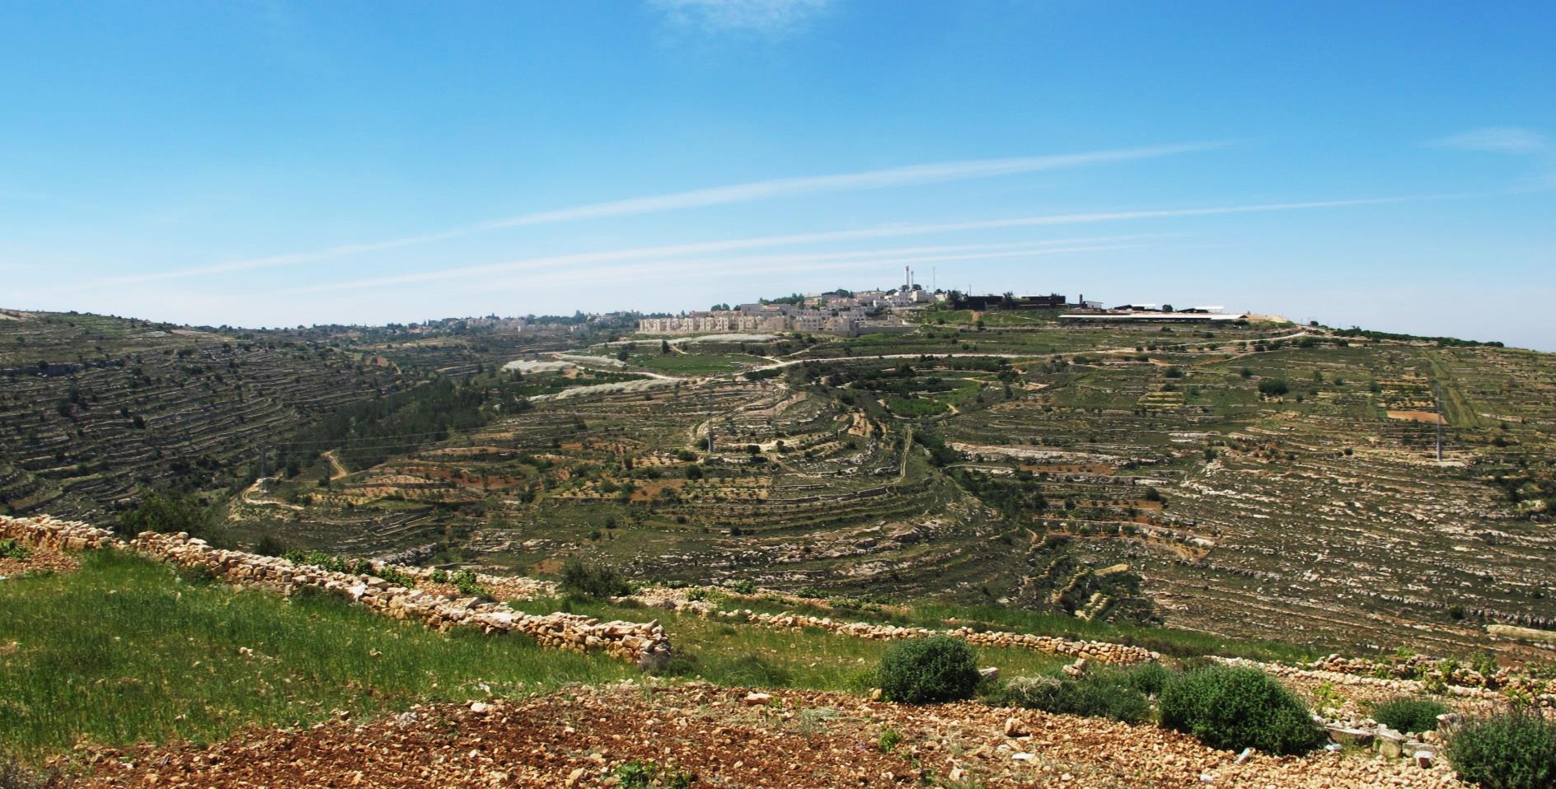
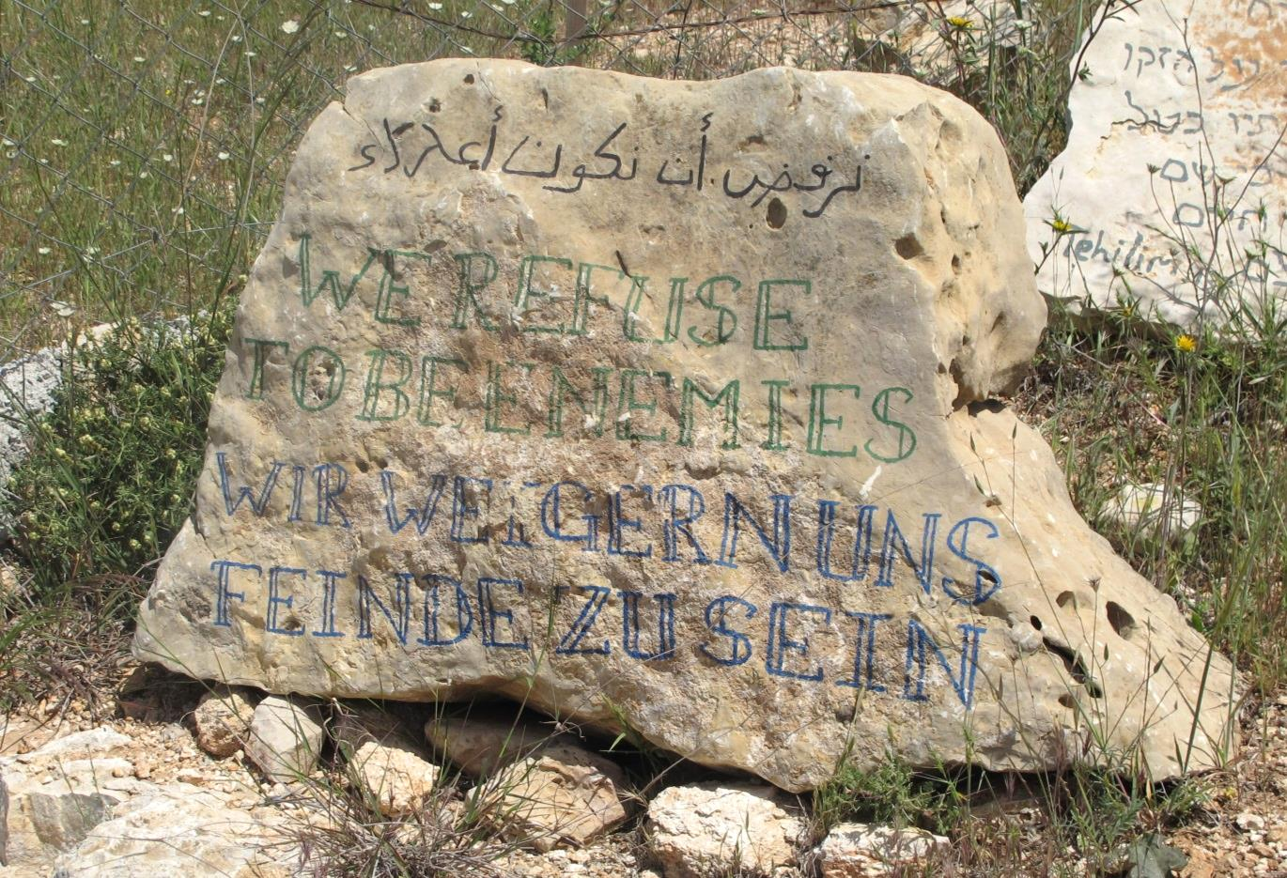
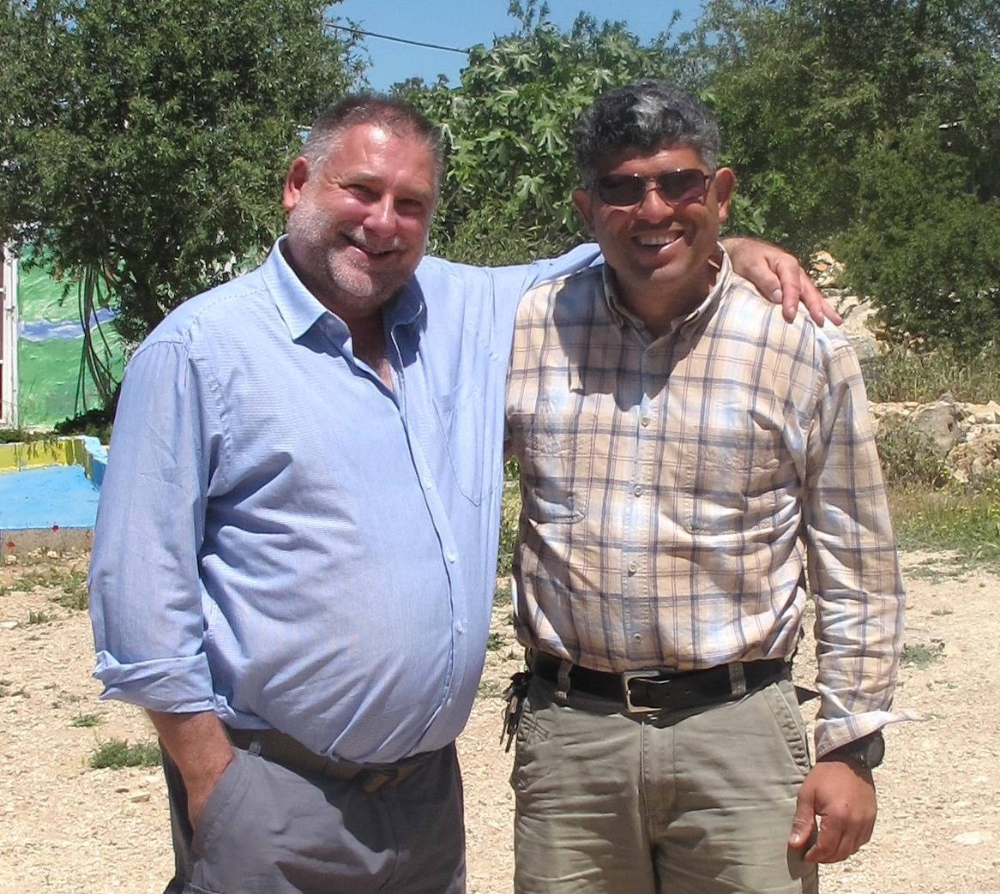
0 CE 500 CE 1000 CE 1500 CE 2000CE
A (simplified) history of the Arab-Israeli conflict
Notes:
International law

Slide 21

Possible Solutions:
“push Israel back into the sea”
the entire land for Israel
the “One State” solution
not acceptable to Israel / lack of trust / Arab birth rate
“Two State solution”
steps in that direction have not been positive for Israel /
need to link West Bank and Gaza / not acceptable to radical
Palestinians / issues of settlements and proportion of land
A (simplified) history of the Arab-Israeli conflict
Notes:
Ben Gurion to Knesset in 1961

Slide 22


An Israeli
perspective

Slide 23

Jewish people accepted the United Nations proposals - the Arab peoples did not
the conflict in 1948 arose when a military coalition of five Arab nations attacked Israel
the subsequent Israeli land gains were fairly won
the “Arabs” – whose language is Arabic – entered the land over hundreds of years from Arabic nations
the people of Israel had been there for thousands of years before
An Israeli perspective

Slide 24
“Arab” people have many other lands where they could live – Israel has only one
what have been won in the State of Israel must be resolutely defended to the end
Israel has sought peace, and (with Oslo) offered Palestinians the chance to show that the can govern
Hamas will not recognise Israel
Palestine must first reject terrorism
freedoms offered after Oslo resulted in new attacks
An Israeli perspective

Slide 25
the Defence Wall was caused by terrorism
the Israeli military presence in A, B and C is necessary to defend Israelis
funding for the rebuilding of Gaza was used to create offensive attacks on Israel
the Arab failure to establish a State means the only default legal system is that of Israel
Israel must have defensible borders
An Israeli perspective

Slide 26

An Israeli perspective

Slide 27
This presentation remains text & photos © Mike Fuller 2015-2019 (other images used with permission).
It may be freely used to inform and encourage others, PROVIDED the author is acknowledged and no changes are made

