Slide 1
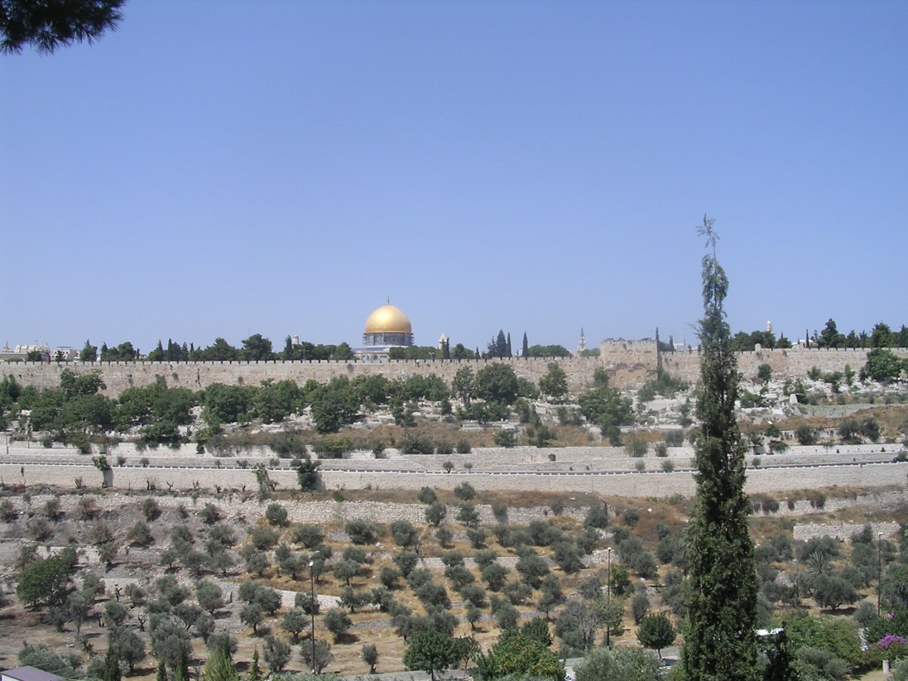
The Walls
of Jerusalem

Slide 2

Moses
Exile
Abraham
David
Jesus
2000 BCE 1500 BCE 1000 BCE 500 BCE 0 500 CE
Bible History for Complete Bozos

Slide 3


2000 BCE 1500 BCE 1000 BCE 500 BCE 0 500 CE 1000CE 1500CE 2000CE
D
The walls we see today
Mount of Olives
The Dome of the Rock
J
Jaffa Gate
J
D
Damascus Gate
N
W
E
S

Slide 4
2000 BCE 1500 BCE 1000 BCE 500 BCE 0 500 CE 1000CE 1500CE 2000CE
Mount of Olives
Mount Moriah
Today’s walls
Before David – Melchizedek is king of Salem
Abraham brings Isaac to Mount Moriah
Canaanite, then Jebusite rule
N
W
E
S

Slide 5
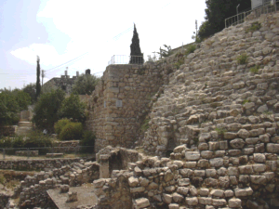
2000 BCE 1500 BCE 1000 BCE 500 BCE 0 500 CE 1000CE 1500CE 2000CE
Mount of Olives
Today’s walls
David – conquers Jerusalem and establishes city
N
W
E
S

Slide 6
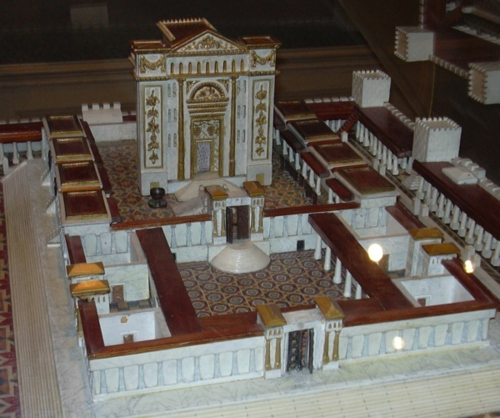
2000 BCE 1500 BCE 1000 BCE 500 BCE 0 500 CE 1000CE 1500CE 2000CE
Mount of Olives
T1
Today’s walls
Solomon – extends city and builds first Temple
N
W
E
S

Slide 7
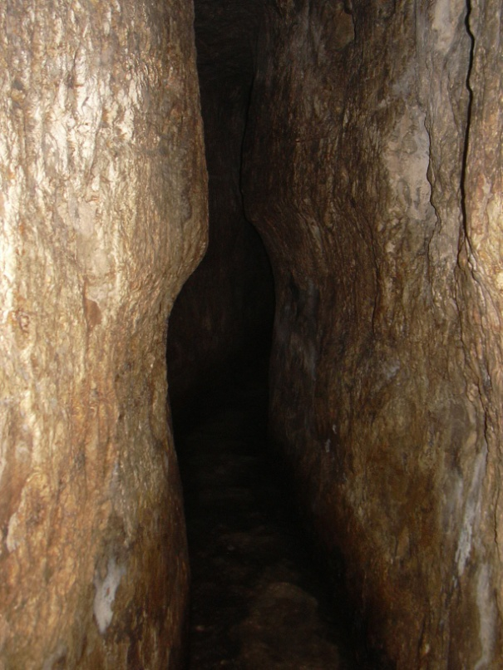
2000 BCE 1500 BCE 1000 BCE 500 BCE 0 500 CE 1000CE 1500CE 2000CE
Mount of Olives
T1
Today’s walls
Time of Isaiah and Hezekiah
(Northern Kingdom falls to Assyria)
N
W
E
S

Slide 8
2000 BCE 1500 BCE 1000 BCE 500 BCE 0 500 CE 1000CE 1500CE 2000CE
Mount of Olives
Today’s walls
Exile.
Southern Kingdom falls to Babylon, first Temple destroyed.
N
W
E
S

Slide 9
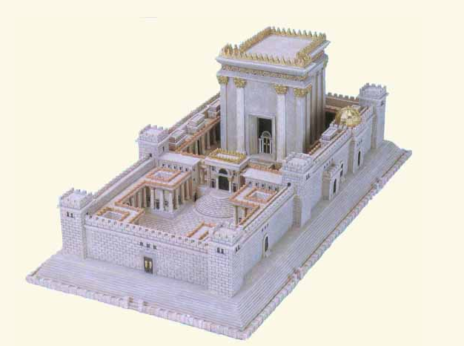
2000 BCE 1500 BCE 1000 BCE 500 BCE 0 500 CE 1000CE 1500CE 2000CE
Mount of Olives
T2
Today’s walls
Return under Nehemiah.
Second Temple built.
Ruled by Persia, then Greeks, then Rome.
N
W
E
S

Slide 10
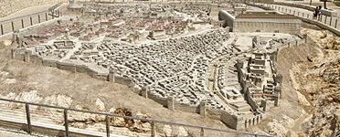
2000 BCE 1500 BCE 1000 BCE 500 BCE 0 500 CE 1000CE 1500CE 2000CE
Garden Tomb today →

Antonia fortress ↓
Mount of Olives
Ch of HS →
today

T2.1
Today’s walls
The time of Jesus.
Still under Roman rule. Herod extends Temple mount.
N
W
E
S

Slide 11
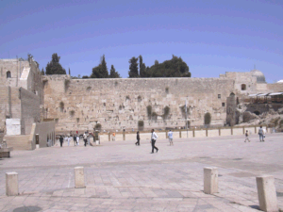
2000 BCE 1500 BCE 1000 BCE 500 BCE 0 500 CE 1000CE 1500CE 2000CE

D
Mount of Olives

T2.1
Today’s walls
Expansion 37-44 CE
Still under Roman rule. First Damascus Gate
N
W
E
S

Slide 12
2000 BCE 1500 BCE 1000 BCE 500 BCE 0 500 CE 1000CE 1500CE 2000CE
Mount of Olives
Today’s walls
N
Destruction – 70 CE
W
E
S

Slide 13
2000 BCE 1500 BCE 1000 BCE 500 BCE 0 500 CE 1000CE 1500CE 2000CE
D
Mount of Olives

Today’s walls
Beginning of Byzantine era.
Helena builds (first) Church of Holy Sepulchre.
N
W
E
S

Slide 14
2000 BCE 1500 BCE 1000 BCE 500 BCE 0 500 CE 1000CE 1500CE 2000CE
D
Mount of Olives

Today’s walls
Muslim conquest.
First Mosque built on Dome of Rock.
N
W
E
S

Slide 15
2000 BCE 1500 BCE 1000 BCE 500 BCE 0 500 CE 1000CE 1500CE 2000CE
D
Mount of Olives

J
Today’s walls
Crusaders – brief rule. Jerusalem won and lost and won and lost. Church of Holy Sepulchre destroyed and rebuilt.
N
W
E
S

Slide 16
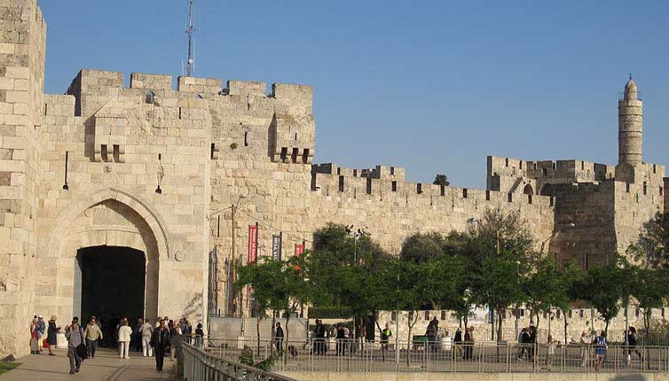
2000 BCE 1500 BCE 1000 BCE 500 BCE 0 500 CE 1000CE 1500CE 2000CE
D
Mount of Olives

J
Today’s walls
The Ottomans – Suleiman the Magnificent.
Existing city walls built.
N
W
E
S

Slide 17

2000 BCE 1500 BCE 1000 BCE 500 BCE 0 500 CE 1000CE 1500CE 2000CE
D
Mount of Olives

J
Today’s walls
The Ottomans – 1883: General Gordon’s Calvary
1892: Garden Tomb purchase initiated
N
W
E
S

Slide 18
2000 BCE 1500 BCE 1000 BCE 500 BCE 0 500 CE 1000CE 1500CE 2000CE
D
Mount of Olives

J
Today’s walls
British Mandate from 1917
N
W
E
S

Slide 19
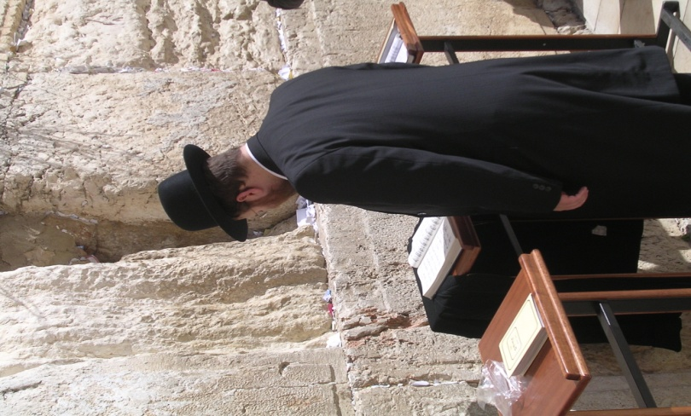
2000 BCE 1500 BCE 1000 BCE 500 BCE 0 500 CE 1000CE 1500CE 2000CE
D
Mount of Olives

J
Today’s walls
State of Israel 1948
Old city initially under Jordan, taken in 1967
Jewish quarter developed
N
W
E
S

