Slide 2

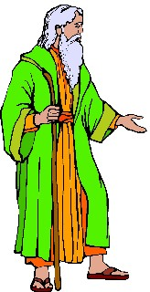

How do the Bible promises to Israel connect with the State of Israel today?

Slide 3

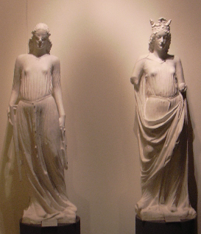

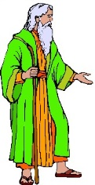
How do the Bible promises to Israel connect with the State of Israel today?
Notes:
NOT a political history. Will not explore either deep roots of anti-Semitism in the Christian Church, or the harm committed by Palestinian terrorists or the Israeli Defence Force, or the sufferings that have grown from settlements and the “Defence Wall”

Slide 4

How do the Bible promises to Israel connect with the State of Israel today?

Slide 5

How do the Bible promises to Israel connect with the State of Israel today?
Notes:
BOMB 29th January 2004 Keren Milchiker

Slide 6

How do the Bible promises to Israel connect with the State of Israel today?

Slide 7
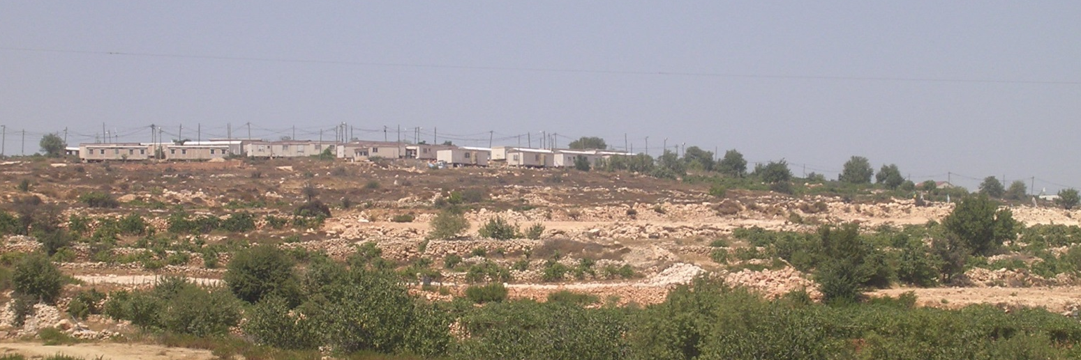
How do the Bible promises to Israel connect with the State of Israel today?

Slide 8
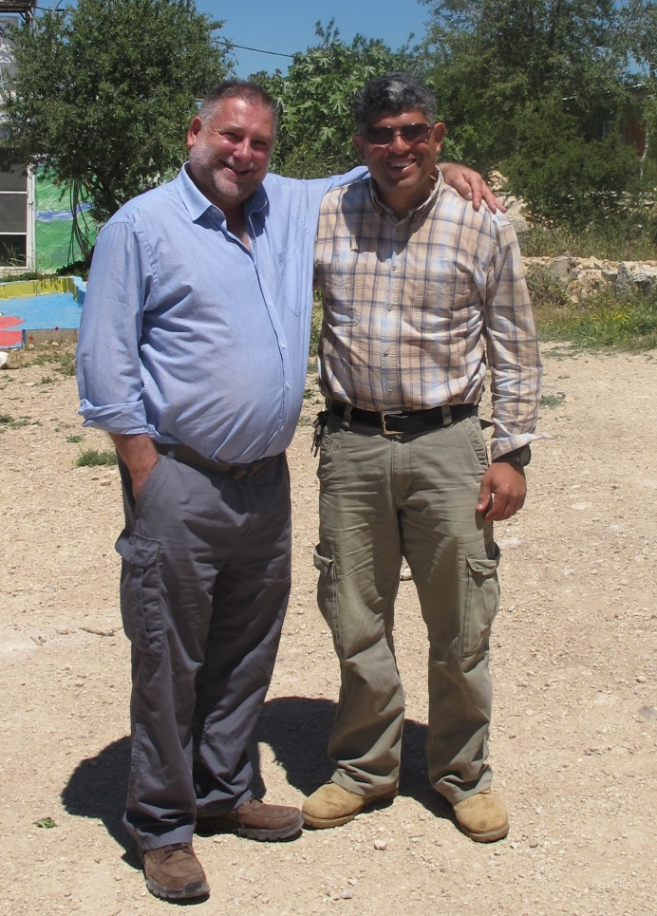
How do the Bible promises to Israel connect with the State of Israel today?

Slide 9
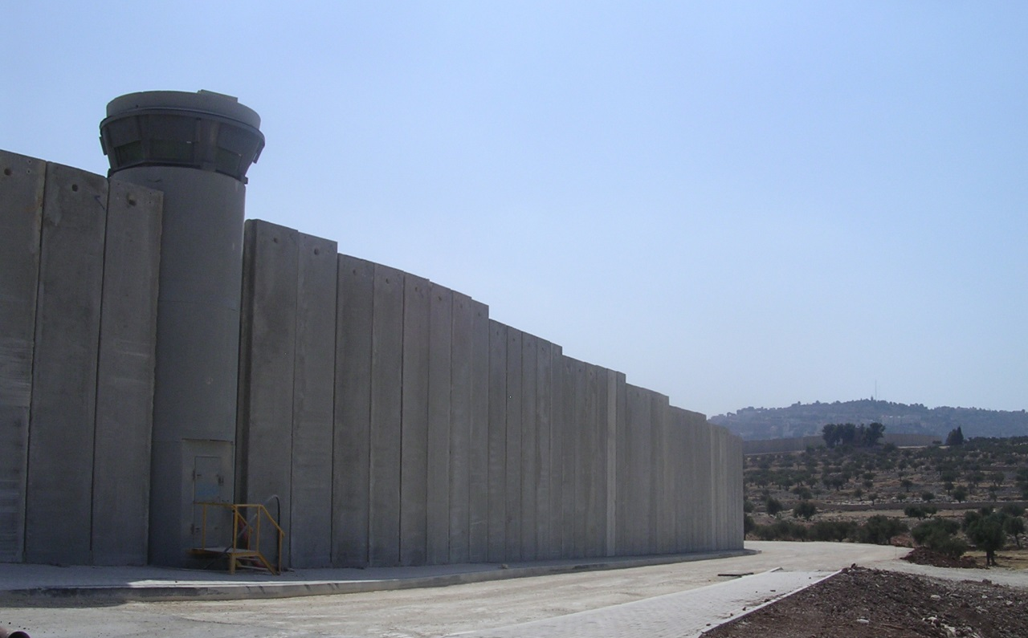
How do the Bible promises to Israel connect with the State of Israel today?

Slide 10
What are “Israel” and “Palestine”?
What were the promises made about the Land?
What land was actually taken in Bible times?
Were the promises outright – or conditional?
Do the Exilic “return” prophecies refer to modern times?
How do different people understand all this?
How do the Bible promises to Israel connect with the State of Israel today?
Notes:
NOT a political history. Will not explore either deep roots of anti-Semitism in the Christian Church, or the harm committed by Palestinian terrorists or the Israeli Defence Force, or the sufferings that have grown from settlements and the “Defence Wall”

Slide 11
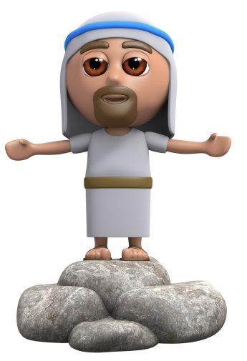
Luke 10 ²⁵ On one occasion an expert in the law stood up to test Jesus. “Teacher,” he asked, “what must I do to inherit eternal life?”
²⁶ “What is written in the Law?” he replied. “How do you read it?”
How do the Bible promises to Israel connect with the State of Israel today?
Notes:
NOT a political history. Will not explore either deep roots of anti-Semitism in the Christian Church, or the harm committed by Palestinian terrorists or the Israeli Defence Force, or the sufferings that have grown from settlements and the “Defence Wall”

Slide 12
Luke 10 ²⁵ On one occasion an expert in the law stood up to test Jesus. “Teacher,” he asked, “what must I do to inherit eternal life?”
²⁶ “What is written in the Law?” he replied. “How do you read it?”
How do the Bible promises to Israel connect with the State of Israel today?

Slide 13



Zack’s closest theological friends are Fred and Charlie – interpreting scripture in quite a literal way
Pete’s closest theological friends are Eve, Ralph and Pippa – interpreting scripture contextually, giving weight to changes in culture
Palestinian Pete
Zionist Zack
Conservative Charlie
Radical Ralph
Fundamentalist Fred
The Bible: infallible
The Bible: inspirational
Post-modern Pippa
Evangelical Eve
The Bible: literally true
The Bible: experiential
The Bible: authoritative
How do the Bible promises to Israel connect with the State of Israel today?

Slide 14
Both followers of Jesus
Both accept authority of the Bible
Both accept the other as a brother in Christ
BUT
They disagree on how to interpret the Bible
Palestinian Pete
Zionist Zack
How do the Bible promises to Israel connect with the State of Israel today?

Slide 15

Israel
Jacob’s new name – “struggles with God” Genesis 32
the people descended from Jacob who inherit the promise to Abraham Deuteronomy 6 ⁴; c.f. Matthew 10 ⁶
northern kingdom after division of monarchy 1 Kings 12
the land promised to Abraham 1 Samuel 17 ⁴⁶
the Jewish state founded in 1948
How do the Bible promises to Israel connect with the State of Israel today?

Slide 16

Palestine
probably derived from “Philistine” (p-l-s-t)
used by Greek writers in 5th and 4th centuries BCE
province in Roman Empire from 2nd century CE
widely used for area of biblical Israel in Europe up to and including British mandate in 20th century
All Palestine Government established 1948
How do the Bible promises to Israel connect with the State of Israel today?
Notes:
p-l-s-t 20th dynasty Egypt 1150 BCE
Assyrians: Palashtu 800 BCE
Herodotus: 5th century BCE BUT oldest MSS 900 CE
Aristotle: 340 BCE

Slide 17
Palestine
defined as homeland of Arab Palestinian people in 1968 (claiming land within British mandate)
State of Palestine declared in 1988 (referring now to West Bank and Gaza Strip)
designated “observer” status at United Nations 2012
137 of 193 UN states had recognised Palestine as a State by 2018
How do the Bible promises to Israel connect with the State of Israel today?
Notes:
136 / 193 diplomatic recognition.
UK: recognises non-member observer status: 274:12 vote 2014
Scotland: 2014 called for recognition
US: would veto full recognition

Slide 18
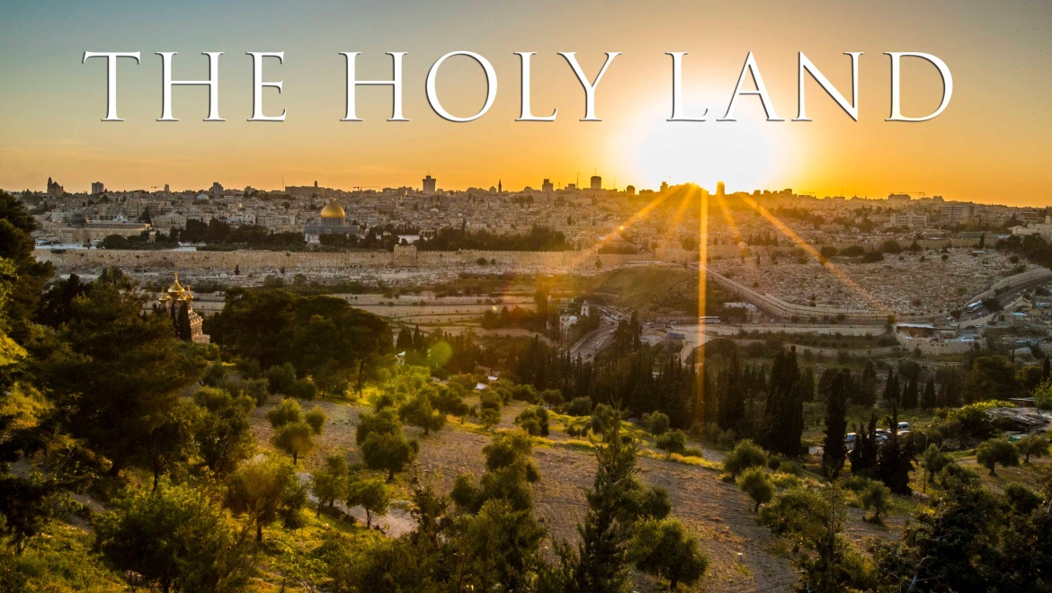

How should we refer to the Land?
How do the Bible promises to Israel connect with the State of Israel today?

Slide 19
How should we refer to the Land?
G-d gave us this land, and it’s been called Israel since more than 3000 years ago!
Palestinian Pete
Zionist Zack
How do the Bible promises to Israel connect with the State of Israel today?

Slide 20
How should we refer to the Land?
My ancestors lived here for hundreds of years – and it’s always been called Palestine!
Palestinian Pete
Zionist Zack
How do the Bible promises to Israel connect with the State of Israel today?

Slide 21
How should we refer to the Land?
“Palestine” is a name given by a pagan emperor – Christians should use the name G-d gave!
Palestinian Pete
Zionist Zack
How do the Bible promises to Israel connect with the State of Israel today?

Slide 22
How should we refer to the Land?
The international community recognises the country of Palestine – so you should as well!
Palestinian Pete
Zionist Zack
How do the Bible promises to Israel connect with the State of Israel today?

Slide 23
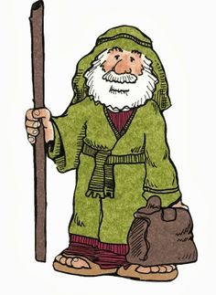
What promises did God make?
The promise to Abraham:
“The whole land of Canaan, where you now reside as a foreigner, I will give as an everlasting possession to you and your descendants after you; and I will be their God.” Genesis 17 ⁸
How do the Bible promises to Israel connect with the State of Israel today?
Notes:
Debate about which Arab peoples descended from Ishmael

Slide 24

What promises did God make?
The promise to Isaac:
“ … to you and your descendants I will give all these lands and will confirm the oath I swore to your father Abraham.” Genesis 26 ³
How do the Bible promises to Israel connect with the State of Israel today?

Slide 25

What promises did God make?
The promise to Jacob:
“I am the Lord, the God of your father Abraham and the God of Isaac. I will give you and your descendants the land on which you are lying. ” Genesis 28 ¹³
How do the Bible promises to Israel connect with the State of Israel today?

Slide 26
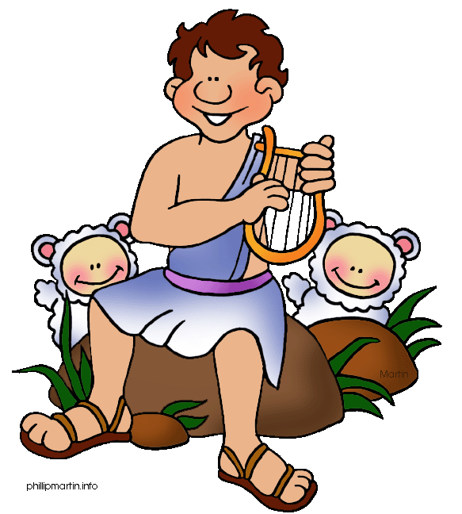
What promises did God make?
The promise confirmed in Psalms:
“(The Lord) remembers his covenant for ever … made with Abraham …
swore to Isaac … confirmed … to Jacob … to Israel as an everlasting covenant:
‘To you I will give the land of Canaan as the portion you will inherit.’” Psalm 105 ⁸⁻¹¹
How do the Bible promises to Israel connect with the State of Israel today?

Slide 27
What promises did God make?
The extent of the land:
“… the Lord made a covenant with Abram and said, ‘To your descendants I give this land, from the Wadi of Egypt to the great river, the Euphrates …” Genesis 15 ¹⁸
How do the Bible promises to Israel connect with the State of Israel today?

Slide 28
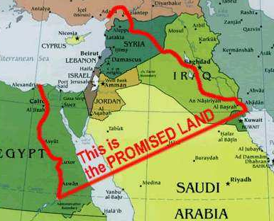
What promises did God make?
That’s what it says – so that’s how it is!
Fundamentalist Fred
How do the Bible promises to Israel connect with the State of Israel today?

Slide 29
What promises did God make?
BUT …
God gives more instructions:
How do the Bible promises to Israel connect with the State of Israel today?

Slide 30

What promises did God make?
In Numbers, God warns of the consequences if the people do not take all the land … Numbers 33 ⁵⁵ ; see Judges 2³
Clearly a later addition when the text was edited during the Exile!
Radical Ralph
How do the Bible promises to Israel connect with the State of Israel today?
Notes:
“‘But if you do not drive out the inhabitants of the land, those you allow to remain will become barbs in your eyes and thorns in your sides. They will give you trouble in the land where you will live. And then I will do to you what I plan to do to them.’”

Slide 31
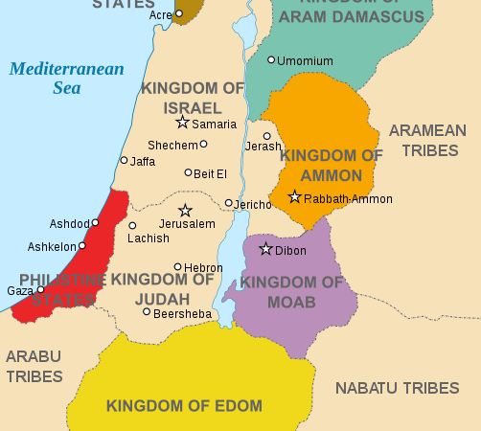
What promises did God make?
In Deuteronomy, Moses says God has commanded them not to take Edom, Moab or Ammon … Deuteronomy 2 ⁹
How do the Bible promises to Israel connect with the State of Israel today?

Slide 32
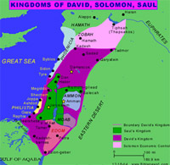
What land was actually taken?
Territory held at the height of Israel’s influence in biblical times
How do the Bible promises to Israel connect with the State of Israel today?

Slide 33
Were the promises conditional?
The promise to Abraham is followed by a requirement to keep the covenant:
“ The whole land of Canaan, where you now reside as a foreigners, I will give as an everlasting possession to you and your descendants after you; and I will be their God.’ Then God said to Abraham, ‘As for you, you must keep my covenant, you and your descendants … Genesis 17 ⁷⁻⁹
How do the Bible promises to Israel connect with the State of Israel today?

Slide 34

Were the promises conditional?
The law includes a threat:
“… if you defile the land, it will vomit you out as it vomited out the nations that were before you”. Leviticus 18 ²⁸
How do the Bible promises to Israel connect with the State of Israel today?

Slide 35
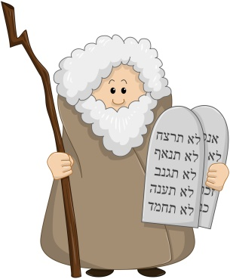
Were the promises conditional?
The covenant at Sinai has blessings for obedience, and curses for disobedience:
“If you do not obey the Lord your God … you will be uprooted from the land you are entering to possess.” Deuteronomy 28 ^{15. 63}
How do the Bible promises to Israel connect with the State of Israel today?

Slide 36
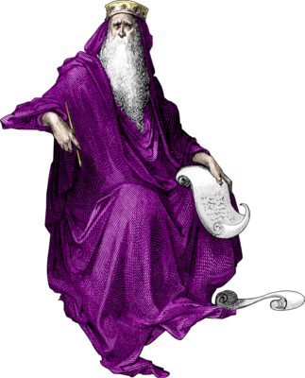
Were the promises conditional?
Solomon is told:
‘But if you or your descendants turn away from me and do not observe the commands and decrees I have given you … then I will cut off Israel from the land I have given them …’ 1 Kings 9 ^{6,7}
How do the Bible promises to Israel connect with the State of Israel today?

Slide 37
Were the promises conditional?
Many Bible scholars see the whole of Deuteronomy to 2 Kings as an extended commentary on the failure of Israel to keep their side of the covenant, and the consequent Exile and loss of the Land …
How do the Bible promises to Israel connect with the State of Israel today?

Slide 38

Were the promises conditional?
… but after the Exile, return to the Land is promised:
“… he said to me: ‘Son of man, these bones are the people of Israel … This is what the Sovereign Lord says: my people, I am going to open your graves and bring you up from them; I will bring you back to the land of Israel.” Ezekiel 37 ^{11. 12}
These promises appear to some to be unconditional
How do the Bible promises to Israel connect with the State of Israel today?

Slide 39

Were the promises conditional?
Some thoughts so far …
the whole Promised Land was never taken
the Land was lost because of disobedience
the Land was re-occupied after Exile …
… then lost again
How do the Bible promises to Israel connect with the State of Israel today?

Slide 40
Were the promises conditional?
No – the gift of the Land was from God’s grace; possession of the Land depended on obedience. The final promises of return are now fulfilled.
Palestinian Pete
Zionist Zack
How do the Bible promises to Israel connect with the State of Israel today?

Slide 41
Were the promises conditional?
Some questions for Zack:
Why have the promises of the full extent of the land not yet been fulfilled?
If the promises were not conditional, why did the Exile happen?
Given the historical fact of Exile, why should we think that this could not happen again?
Palestinian Pete
Zionist Zack
How do the Bible promises to Israel connect with the State of Israel today?

Slide 42
Were the promises conditional?
Yes – and they still are. The State of Israel has no right to the Land while they disobey the command to care for those who live among them.
Palestinian Pete
Zionist Zack
How do the Bible promises to Israel connect with the State of Israel today?

Slide 43
Were the promises conditional?
Some questions for Pete:
What about God’s extraordinary grace?
What then do you believe about God’s “chosen people” – are you claiming that these promises are completely superseded in Christ?
As a believer, don’t you respect the legal decisions of the international community?
Palestinian Pete
Zionist Zack
How do the Bible promises to Israel connect with the State of Israel today?

Slide 44
Do “return” prophecies refer to modern times?
2000 BCE 1500 BCE 1000 BCE 500 BCE 0 500 CE
Abraham
Moses
David
Exile
Jesus
Deuteronomy
Isaiah
Ezekiel
Jeremiah
Bible History for Complete Bozos
How do the Bible promises to Israel connect with the State of Israel today?
Notes:
Even if you have been banished to the most distant land under the heavens, from there the Lord your God will gather you and bring you back. He will bring you to the land that belonged to your fathers, and you will take possession of it. He will make you more prosperous and numerous than your fathers.
Deuteronomy 30:3-5

Slide 45
Do “return” prophecies refer to modern times?
“THIS must be THAT”
2000 BCE 1500 BCE 1000 BCE 500 BCE 0 500 CE
Abraham
Moses
David
Exile
Jesus
“Therefore the Lord himself will give you a sign: The virgin will be with child and will give birth to a son, and will call him Immanuel. He will eat curds and honey when he knows enough to reject the wrong and choose the right. But before the boy knows enough to reject the wrong and choose the right, the land of the two kings you dread will be laid waste. The Lord will bring on you and on your people and on the house of your father a
time unlike any since Ephraim broke away from Judah - he will bring the
king of Assyria.” Isaiah 7 ¹⁴
How do the Bible promises to Israel connect with the State of Israel today?

Slide 46
Do “return” prophecies refer to modern times?
2000 BCE 1500 BCE 1000 BCE 500 BCE 0 500 CE
Abraham
Moses
David
Exile
Jesus
“Before she goes into labour, she gives birth; before the pains come upon her, she delivers a son. Who has ever heard of such a thing? Who has ever seen such things? Can a country be born in a day or a nation be brought forth in a moment? Yet no sooner is Zion in labour than she
gives birth to her children.” Isaiah 66:7-8
How do the Bible promises to Israel connect with the State of Israel today?

Slide 47
Do “return” prophecies refer to modern times?
2000 BCE 1500 BCE 1000 BCE 500 BCE 0 500 CE
Abraham
Moses
David
Exile
Jesus
“Then it will happen on that day that the Lord will again recover the second time with His hand the remnant of His people, who will remain, from Assyria, Egypt, Pathros, Cush, Elam, Shinar, Hamath, and from the islands of the sea. And He will lift up a standard for the nations, and will assemble the banished ones of Israel, and will gather the dispersed of Judah from the four corners of the earth.” Isaiah 11 ^{11,} ¹²
How do the Bible promises to Israel connect with the State of Israel today?

Slide 48
Do “return” prophecies refer to modern times?
Specific references to a second return, in one day, and from the four corners of the earth must mean the return of 1948
Maybe – but this doesn’t mean that the original conditional covenant is no longer valid. Treat us with kindness!
Palestinian Pete
Zionist Zack
How do the Bible promises to Israel connect with the State of Israel today?

Slide 49

How do people understand it all?
we were given the Land again by a miracle
all promises are now fulfilled
this is the only place where we can be safe
Arabs can go and live in Arab countries
we must be able to defend ourselves
we will not tolerate terrorism
Zionist Zack
How do the Bible promises to Israel connect with the State of Israel today?

Slide 50
How do people understand it all?
most Israelis are not religious
promises to Israel are fulfilled in Jesus Land > Kingdom, Temple > Body of Christ, Sacrifice > Jesus – New Covenant
Jesus rejected restoration of the Land Acts 1 ^{6,7}
all inherit from Abraham Galatians 3 ²⁹
our DNA is more Semitic than Jews
we deserve our own State – or equality in one State
Palestinian Pete
How do the Bible promises to Israel connect with the State of Israel today?
Notes:
So when they met together, they asked him, “Lord, are you at this time going to restore the kingdom to Israel?”
He said to them: “It is not for you to know the times or dates the Father has set by his own authority. But you will receive power when the Holy Spirit comes on you; and you will be my witnesses in Jerusalem, and in all Judea and Samaria, and to the ends of the earth.” Acts 1 ^{6,7}
If you belong to Christ, then you are Abraham’s seed, and heirs according to the promise. Galatians 3 ²⁹

Slide 51


How do people understand it all?
finally … some do not approach these questions from the authority of the Bible …
How do the Bible promises to Israel connect with the State of Israel today?

Slide 52

How do people understand it all?
all territory Allah has given us should then be ours for all time
all Muslims should help defend us when we are attacked
we have lived here peacefully for very many years, alongside Christians and Jews
we deserve our own State – or full equality in one State
Moderate Muslim Mahmoud
How do the Bible promises to Israel connect with the State of Israel today?

Slide 53

How do people understand it all?
all territory Allah has given us should then be ours for all time
we will fight to defend the Ummah with our last drop of blood
Israel has no right to exist, and should be driven back into the sea
we will regain our own State
Hardline
Hamas
Hussain
How do the Bible promises to Israel connect with the State of Israel today?

Slide 54
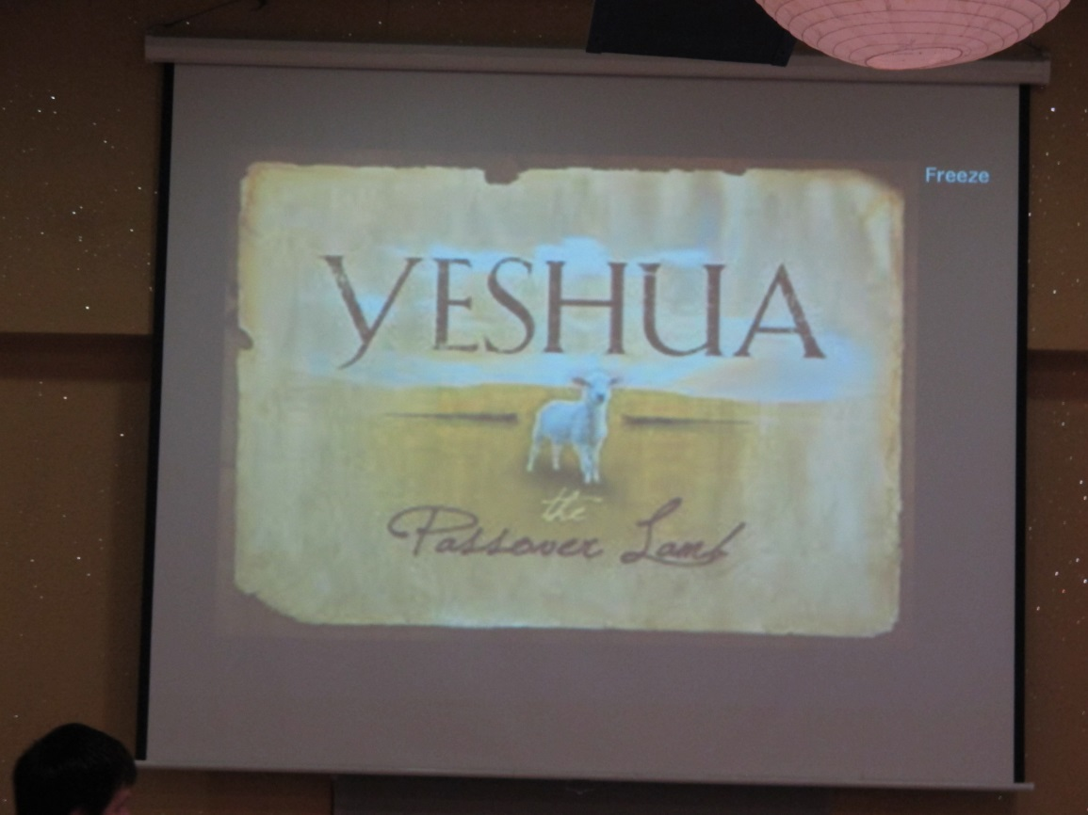
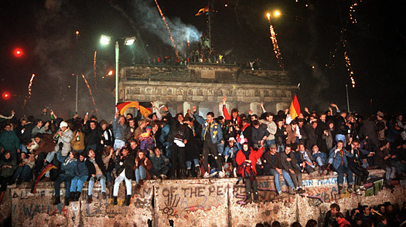
Some glimpses of hope
Notes:
November 9th 1989

Slide 55

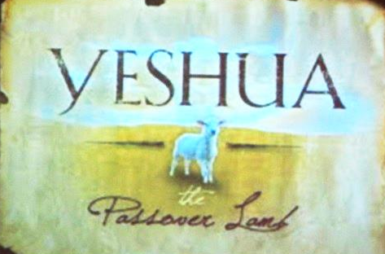
Some glimpses of hope

Slide 56


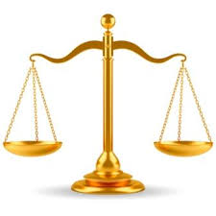
Some glimpses of hope

Slide 57
This presentation text & photos © Mike Fuller 2011-2020 (other images used with permission).
It may be freely used to inform and encourage others, PROVIDED the author is acknowledged and no changes are made

Slide 59
