Slide 1

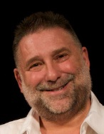
Preparing for pilgrimage to the Holy Land
Mike Fuller
“Reading the Bible with your feet” Graham Tomlin

Slide 2
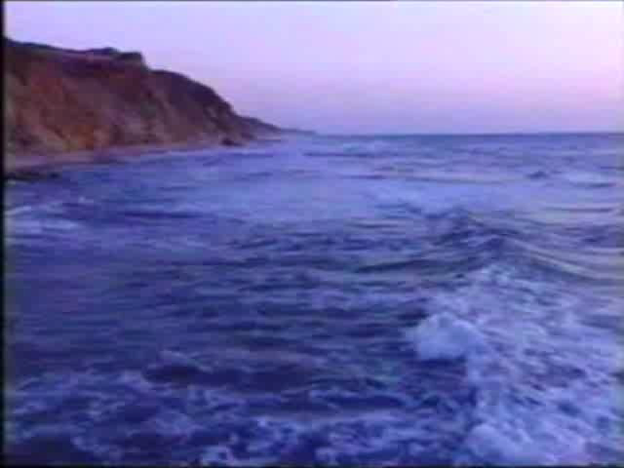
Preparing for pilgrimage to the Holy Land

Slide 3
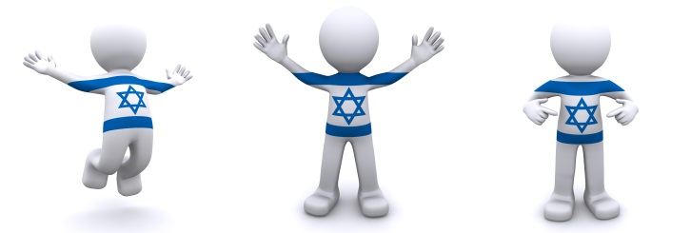
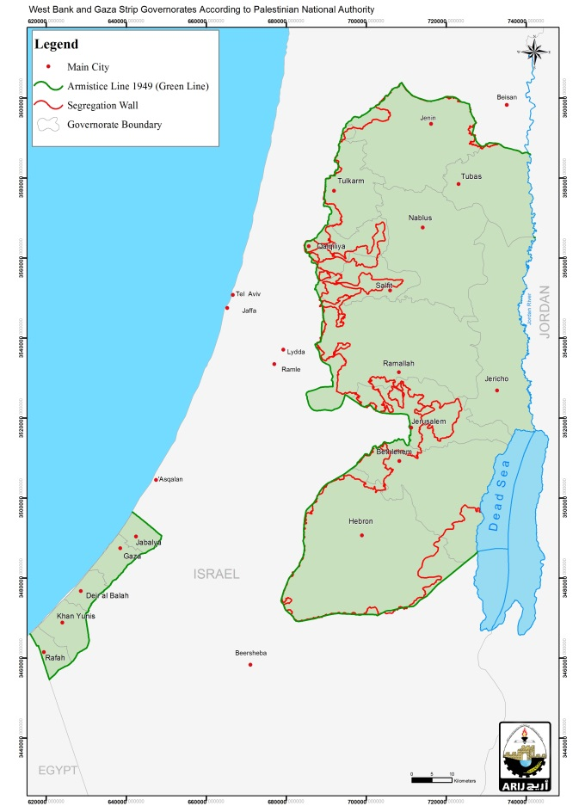
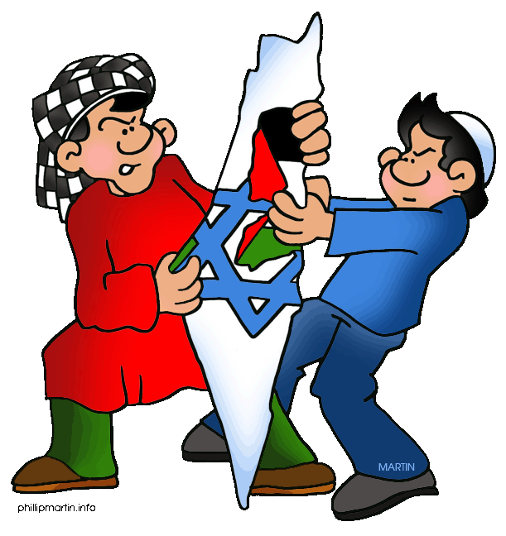
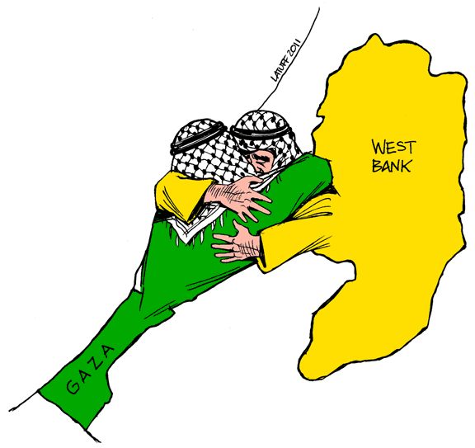
Israel?
Palestine?
Preparing for pilgrimage to the Holy Land

Slide 4




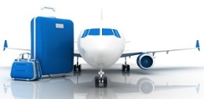




advance preparation
practical preparation
spiritual preparation
the journey out (and back)
the shape of a tour day
tour group etiquette
encountering different views
resources
Preparing for pilgrimage to the Holy Land

Slide 5



1. Advance preparation
Preparing for pilgrimage to the Holy Land

Slide 6
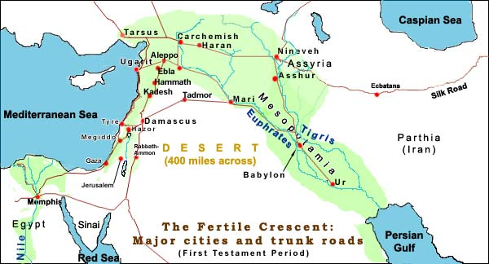
1. Advance preparation
Preparing for pilgrimage to the Holy Land

Slide 7
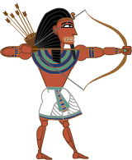
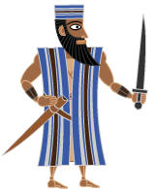

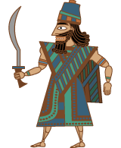
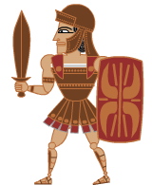
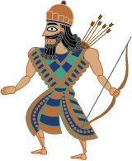
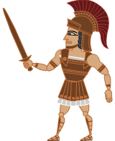

2000 BCE 1500 BCE 1000 BCE 500 BCE 0 500 CE
Abraham
Moses
David
Exile
Jesus
… then are overwhelmed by the Assyrians …
… who are defeated by the Babylonians …
… who succumb to the Persians, who are conquered by the Greeks …
… who are beaten by the Romans …
Egypt rules!
The Israelites …
defeat the Canaanites
Bible History for Complete Bozos
from 586 BCE to 1948 CE, Jewish people do not rule the Land
Preparing for pilgrimage to the Holy Land

Slide 8
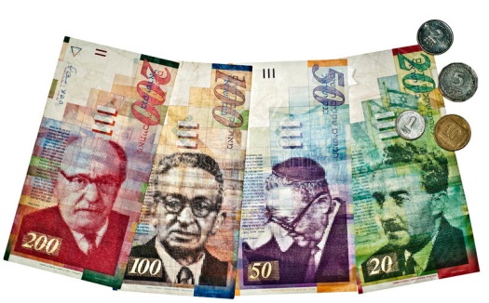

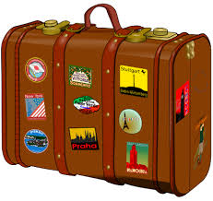



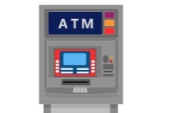






2. Practical preparation
Preparing for pilgrimage to the Holy Land

Slide 9
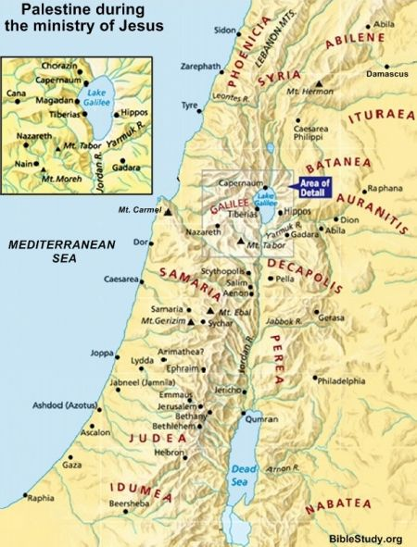





3. Spiritual preparation
Preparing for pilgrimage to the Holy Land

Slide 10
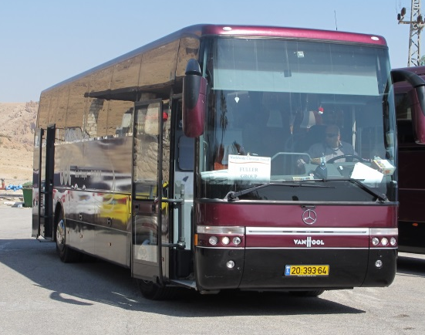


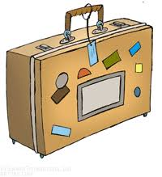

4. The journey out (and back)
Preparing for pilgrimage to the Holy Land

Slide 11
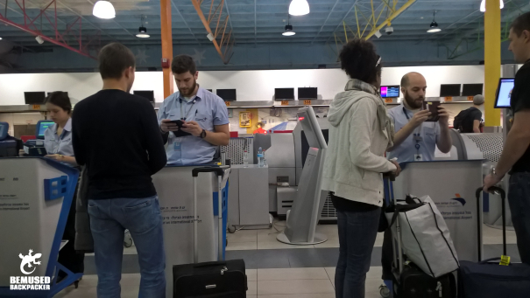
4. The journey out (and back)
Preparing for pilgrimage to the Holy Land

Slide 12
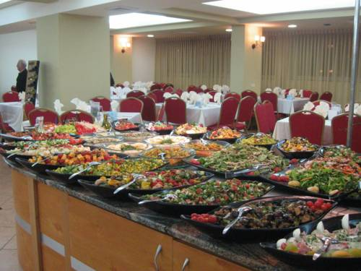

5. The shape of a tour day
0745 Prayer
0800 Buffet breakfast
0845 Depart
1300 Inexpensive lunch
1730 Back to hotel
1900 Evening buffet
Preparing for pilgrimage to the Holy Land

Slide 13
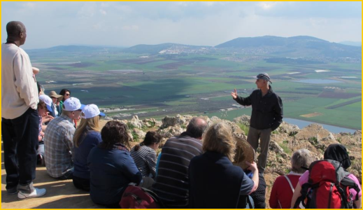
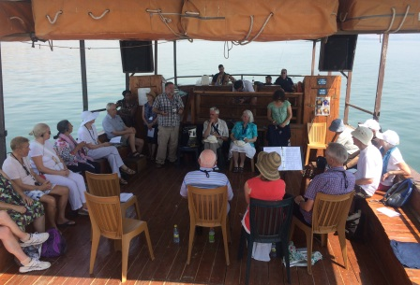
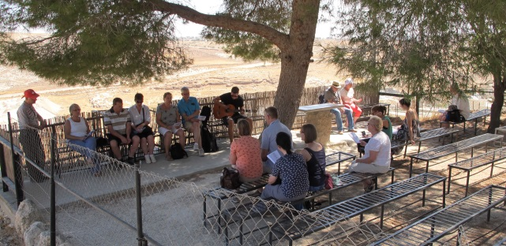
5. The shape of a tour day
0745 Prayer
0800 Buffet breakfast
0845 Depart
1300 Inexpensive lunch
1730 Back to hotel
1900 Evening buffet
Preparing for pilgrimage to the Holy Land

Slide 14
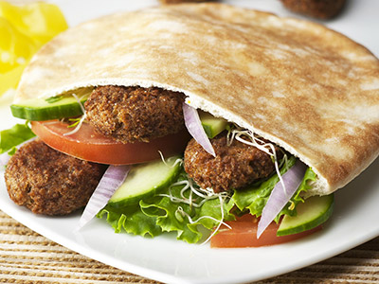
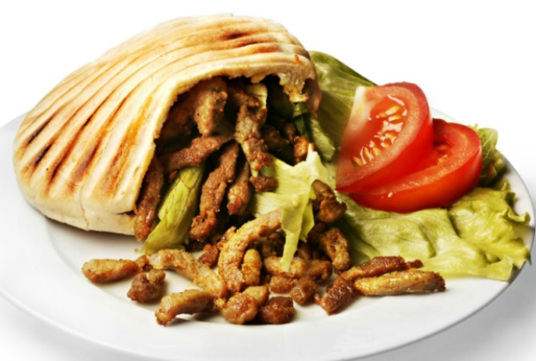
5. The shape of a tour day
0745 Prayer
0800 Buffet breakfast
0845 Depart
1300 Inexpensive lunch
1730 Back to hotel
1900 Evening buffet
Preparing for pilgrimage to the Holy Land

Slide 15







6. Tour group etiquette
Preparing for pilgrimage to the Holy Land

Slide 16
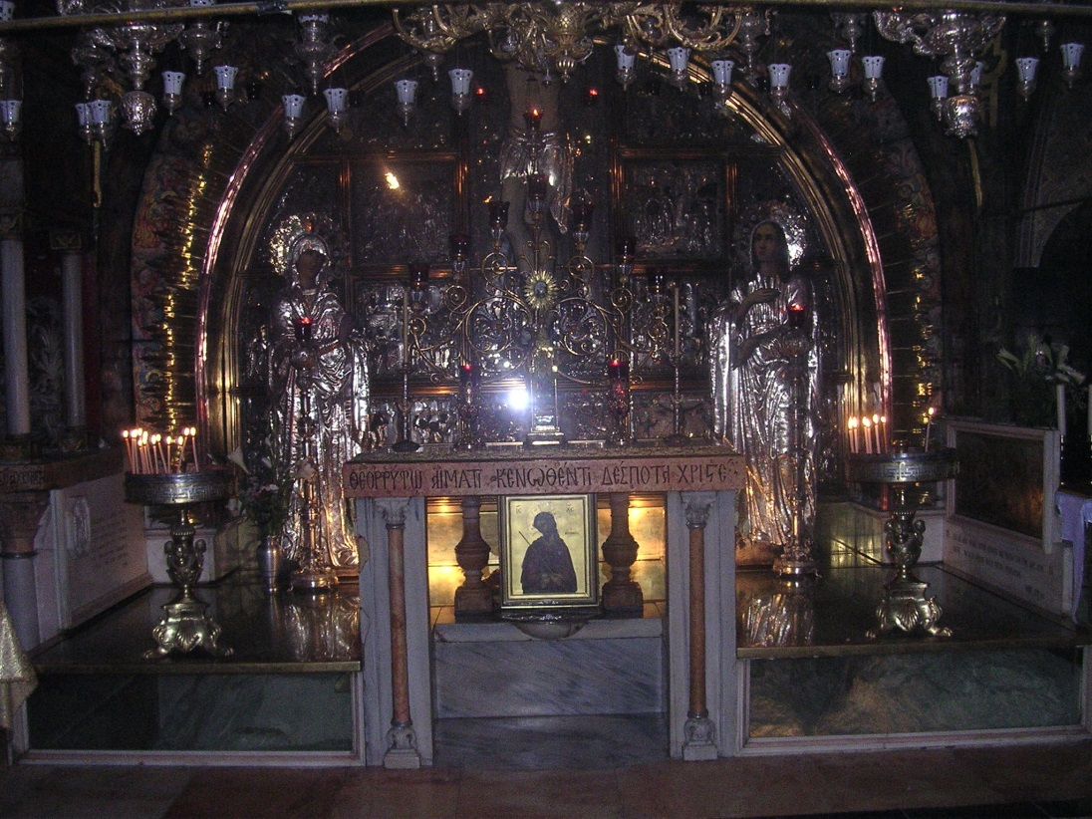

7. Encountering different views
Preparing for pilgrimage to the Holy Land

Slide 17




7. Encountering different views
Zack’s closest theological friends are Fred and Charlie – interpreting scripture in quite a literal way
Pete’s closest theological friends are Eve, Ralph and Pippa – interpreting scripture contextually, giving weight to changes in culture
Palestinian Pete
Zionist Zack
Conservative Charlie
Radical Ralph
Fundamentalist Fred
The Bible: infallible
The Bible: inspirational
Post-modern Pippa
Evangelical Eve
The Bible: literally true
The Bible: experiential
The Bible: authoritative
Preparing for pilgrimage to the Holy Land

Slide 18
7. Encountering different views
Both followers of Jesus
Both accept authority of the Bible
Both accept the other as a brother in Christ
BUT
They disagree on how to interpret the Bible
Palestinian Pete
Zionist Zack
Preparing for pilgrimage to the Holy Land

Slide 19

7. Encountering different views
we were given the Land again by a miracle
all promises are now fulfilled
this is the only place where we can be safe
Arabs can go and live in Arab countries
we must be able to defend ourselves
we will not tolerate terrorism
Zionist Zack
Preparing for pilgrimage to the Holy Land

Slide 20
7. Encountering different views
most Israelis are not religious
promises to Israel are fulfilled in Jesus Land > Kingdom, Temple > Body of Christ, Sacrifice > Jesus – New Covenant
Jesus rejected restoration of the Land Acts 1 ^{6,7}
all inherit from Abraham Galatians 3 ²⁹
our DNA is more Semitic than Jews
we deserve our own State – or equality in one State
Palestinian Pete
Preparing for pilgrimage to the Holy Land
Notes:
So when they met together, they asked him, “Lord, are you at this time going to restore the kingdom to Israel?”
He said to them: “It is not for you to know the times or dates the Father has set by his own authority. But you will receive power when the Holy Spirit comes on you; and you will be my witnesses in Jerusalem, and in all Judea and Samaria, and to the ends of the earth.” Acts 1 ^{6,7}
If you belong to Christ, then you are Abraham’s seed, and heirs according to the promise. Galatians 3 ²⁹

Slide 21
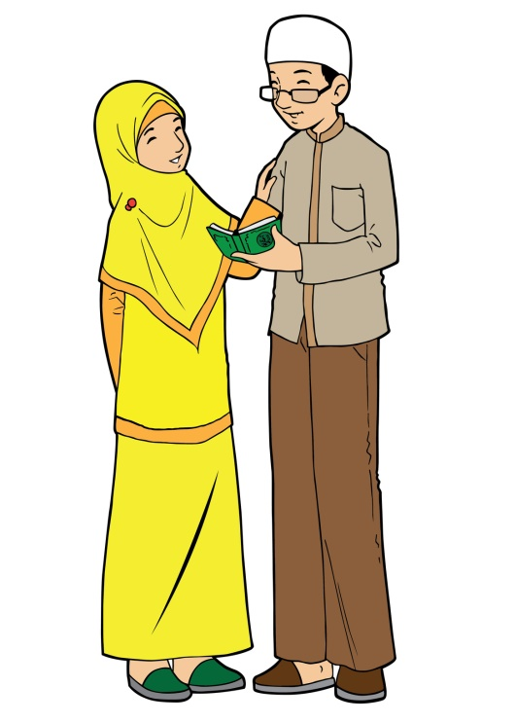

7. Encountering different views
finally … some do not approach these questions from the authority of the Bible …
Preparing for pilgrimage to the Holy Land

Slide 22

7. Encountering different views
all territory Allah has given us should then be ours for all time
all Muslims should help defend us when we are attacked
we have lived here peacefully for very many years, alongside Christians and Jews
we deserve our own State – or full equality in one State
Moderate Muslim Mahmoud
Preparing for pilgrimage to the Holy Land

Slide 23

7. Encountering different views
all territory Allah has given us should then be ours for all time
we will fight to defend the Ummah with our last drop of blood
Israel has no right to exist, and should be driven back into the sea
we will regain our own State
Hardline
Hamas
Hussain
Preparing for pilgrimage to the Holy Land

Slide 24
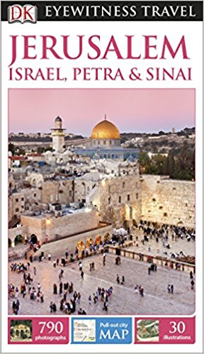
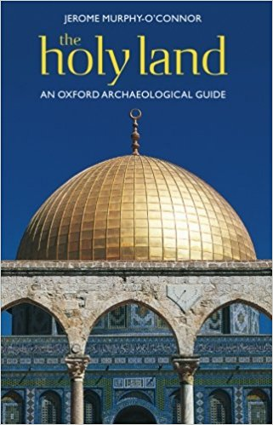

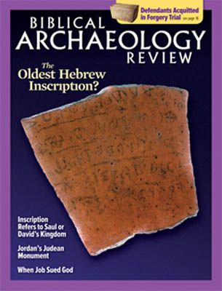

8. Resources
Preparing for pilgrimage to the Holy Land

